Slide 1
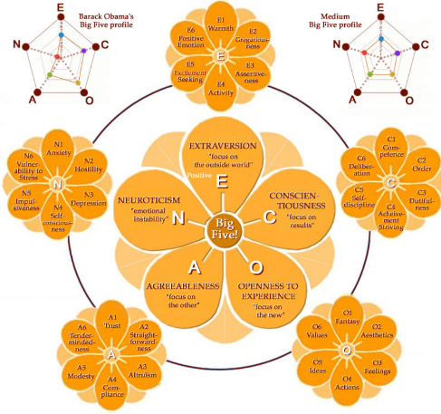
用户大五人格推测
外向性
随和性
神经质
尽责性
开放性

Slide 2
Personality Inference
Notes:
Our approach considers four different data types
Stacked Generalization-based Ensemble, https://en.wikipedia.org/wiki/Ensemble_learning
Paragraph embedding, ICML 2014, https://cs.stanford.edu/~quocle/paragraph_vector.pdf
However, the bag-of-words (BOW) has many disadvantages. The word order is lost, and thus different sentences can have exactly the same representation, as long as the same words are used. Even though bag-of-n-grams considers the word order in short context, it suffers from data sparsity and high dimensionality. Bag-of-words and bag-of-n-grams have very little sense about the semantics of the words or more formally the distances between the words. This means that words “powerful,” “strong” and “Paris” are equally distant despite the fact that semantically, “powerful” should be closer to “strong” than “Paris.

Slide 3
Data
3,162 users from a medical school
Major: nursing (524), clinical medicine (365) and pharmaceutics (342)
Region: Anhui, Zhejiang, and Jiangsu
Age: average 20.84
Test Big Five Personality with a 44-item questionnaire

Slide 4
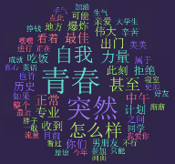
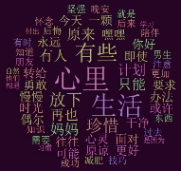


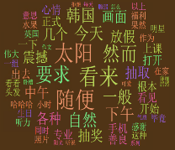
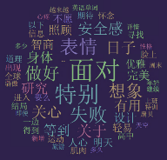
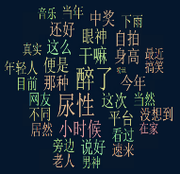
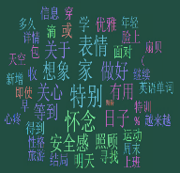

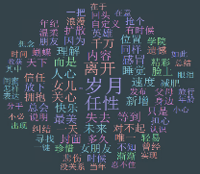
Correlation between Term and Personality
 | Extraversion | Agreeableness | Neuroticism | Conscientiousness | Openness
Positive
Negative
Notes:
Pearson Correlation

Slide 5
Tweets
Category | Example
Affective processes | 高兴, 流泪
Positive emotion | 爱, 不错, 甜蜜
Negative emotion | 悲哀,愁
Anxiety | 担忧,害怕
Anger | 杀,恼怒
Sadness | 寂寞,后悔
Social processes | 他们,兄弟,谈论
Family | 爸,姐妹, 一家人
Friends | 哥们儿,邻居
Female references | 女孩儿，她
LIWC mapping
LIWC is a dictionary which maps words to semantic categories (64 categories which a hierarchical structure)
Paragraph embedding
All tweets of a user form a doc
Embed each doc to a vector by considering the context and semantics of words
TextMind (Chinese LIWC)
Notes:
LIWC: Linguistic Inquiry and Word Count
http://ccpl.psych.ac.cn/textmind/
“文心(TextMind)”中文心理分析系统是由中科院心理所计算网络心理实验室研发的，针对中文文本进行语言分析的软件系统，通过“文心”，您可以便捷地分析文本中使用的不同类别语言的程度、偏好等特点。针对中国大陆地区简体环境下的语言特点，参照LIWC2007和正體中文C-LIWC词库，我们开发了“文心（TextMind）”中文心理分析系统。“文心”为用户提供从简体中文自动分词，到语言心理分析的一揽子分析解决方案，其词库、文字和符号等处理方法专门针对简体中文语境，词库分类体系也与LIWC兼容一致。

Slide 6
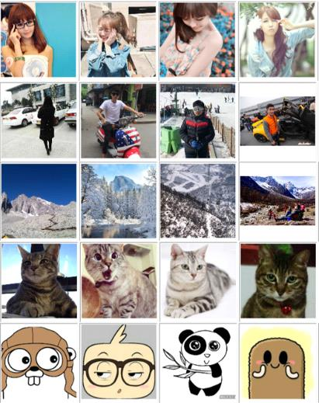
Avatar
Selfie
Pre-trained CNN model on ImageNet
Map each avatar to a 256-dimension embedding vector
Group all images into 2000 categories, each avatar belong to the nearest category
Daily Life
Landscape
Animal
Cartoon
Notes:
http://mp.weixin.qq.com/s?src=3&timestamp=1463474774&ver=1&signature=1Osqt-V72oe5uDMI-L6gK74gbjbUUABSE8KW5iXOT039fuzl-JpgVMh-EuvHZJYVe43io0evaNWuIktd84AvPoQHl7iziXzb5uq1YjKim1myHpVDaWmlZs2JsRXORDysI01a*xmm1IRXo5Br-mAv6WUCt90dIhGC4g3hznHnTxg=
用自己PS过的照片、艺术照、文艺范儿照、装可爱照作头像 往往有较强的自我中心倾向，就是有点自恋啦！其实自恋的外表透露出自卑的内心，不太能接受真实的自己。
用没太刻意选择过的生活照作头像 这类人对自己的接纳度比较高，对外貌也比较有自信，不一定长得好看，但是能接纳自己的本来面目。内心没藏太多秘密，也没做过什么见不得人的事儿，在网络世界和现实世界中差别不大。
用风景美图作头像 这种人通常为人比较成熟，人缘很好，很注重人际关系的和谐。
用猫做头像的女性，性感妩媚有灵气，很爱美，经常会拿出化妆镜照照。很沉浸在自己的小日子里，有一定的自闭倾向。
用卡通图片作头像 他们希望自己能保持一颗纯真的心，讨厌生活变复杂，是比较理想主义的人，想象力和创造力都很强，思维比较开阔。

Slide 7


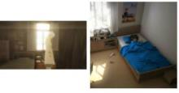

Correlation between Avatar and Personality
 | Extraversion | Agreeableness | Neuroticism | Conscientiousness | Openness
Positive
Negative

Slide 8
From Emoticon to Emotion
Build a dictionary, mapping each emoticon to one of the 8 emotions
Totally 1302 emoticons, 1200 of them have a single emotion
Happiness
Anger
Disgust
Sadness
Fear
Surprise
Contempt
Neutral

Slide 9
Profile
Individual features
Age
Gender
Number of tweets
Have signature
Have personal website
Allow private message from strangers
Allow comments from strangers
Allow showing location
Social features
Number of Followings
Number of Followers
Friend ratio
Comment ratio
Retweet ratio

Slide 10
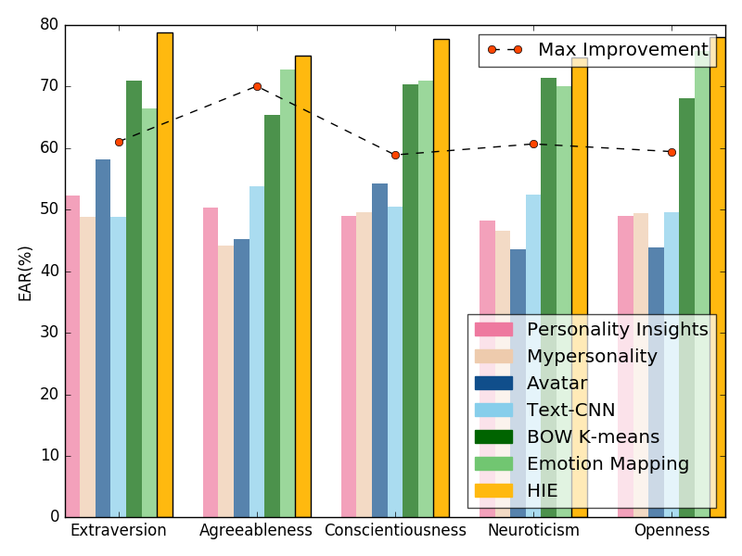
Experimental Results
Honghao Wei, Fuzheng Zhang, Nicholas Jing Yuan, Chuan Cao, etc. Beyond the Words: Predicting User Personality from Heterogeneous Information, WSDM 2017

Slide 11
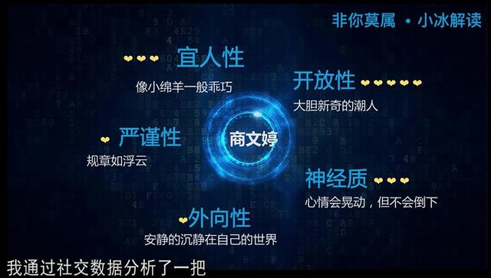
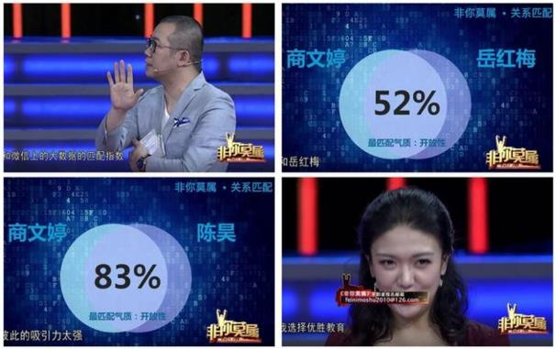
Application in 非你莫属

Slide 12
Novelty Seeking
A personality trait described as the search for unfamiliar experiences and feelings
Measurements: survey based scales
Life innovativeness: measure the adoption of new information in most aspects of life, including products, news….
Adoptive innovativeness: measure the novelty seeking as a tendency to buy new products, the adoption time of a new product
Our goal: Explore novelty-seeking trait in a complete data-driven way
Frequently purchases latest-launched digital products on Amazon → a novelty-seeking-lover in the online shopping domain
Notes:
Fuzheng Zhang, Nicholas Jing Yuan, Defu Lian, Xing Xie, Mining Novelty Seeking Trait Across Heterogeneous Domains, 23rd International World Wide Web Conference (WWW 2014, acceptance rate 84/650=12.9%), Seoul, Korea, Apr. 2014

Slide 13
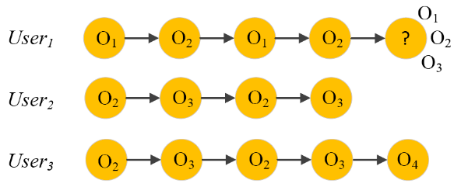
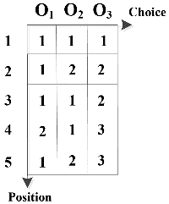
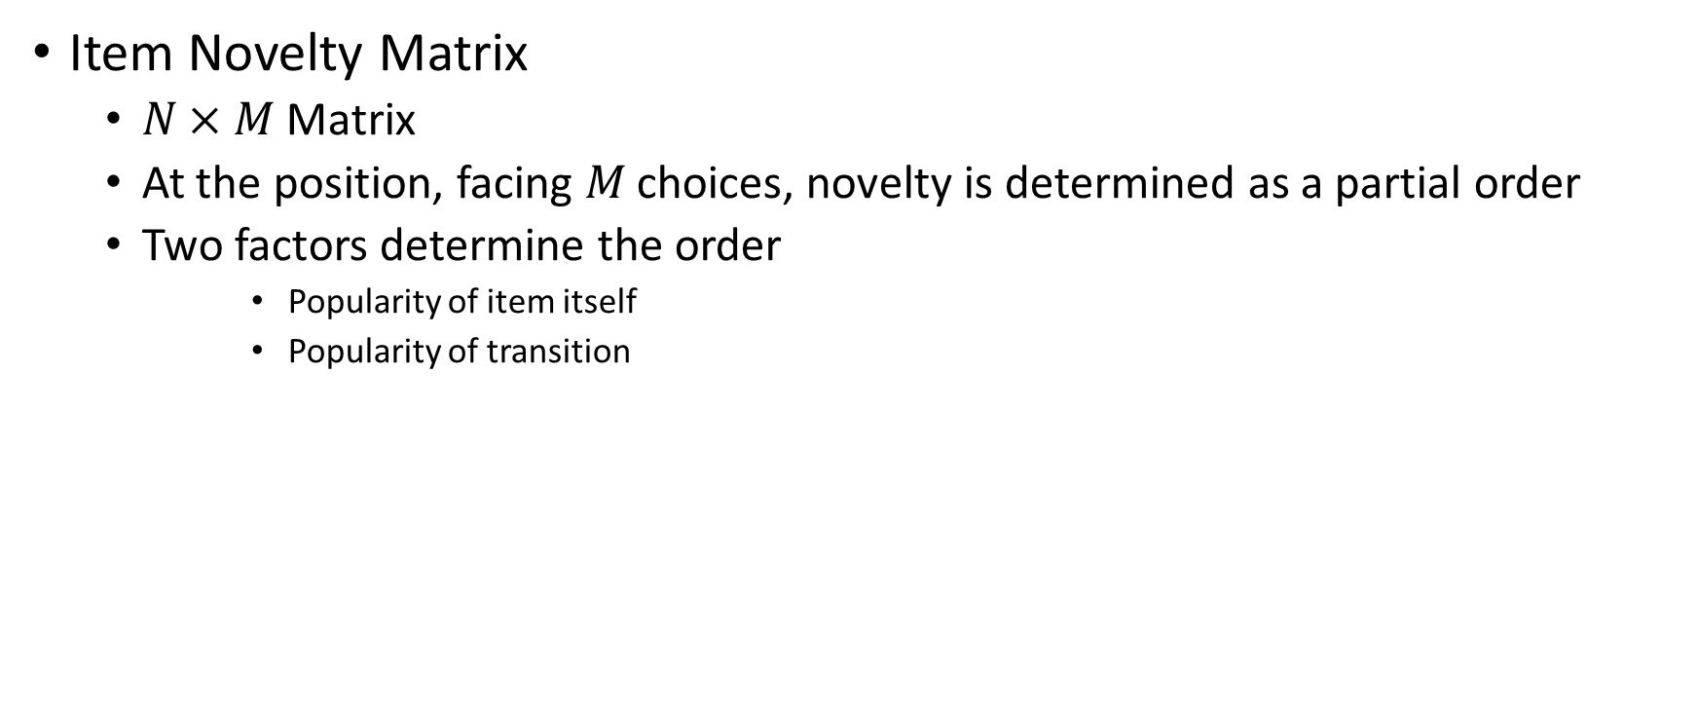
Novelty Seeking Model
Item Novelty Matrix
$N×M$ Matrix
At the position, facing $M$ choices, novelty is determined as a partial order
Two factors determine the order
Popularity of item itself
Popularity of transition
user₁:DCN@Self

Slide 14
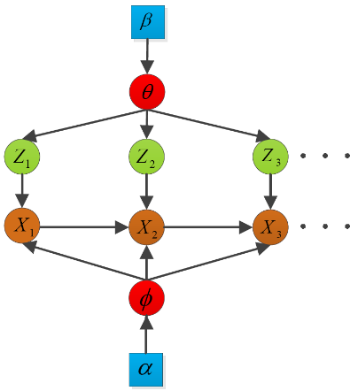
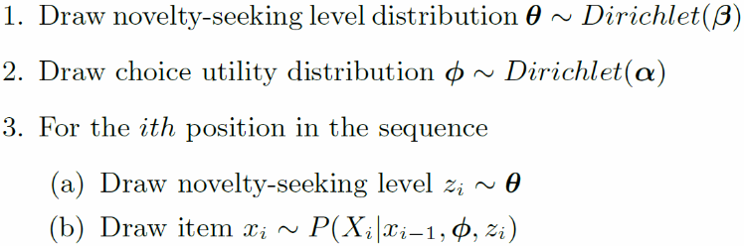
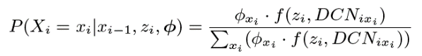
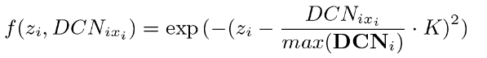
General Novelty-Seeking Model
Generative process

Slide 15
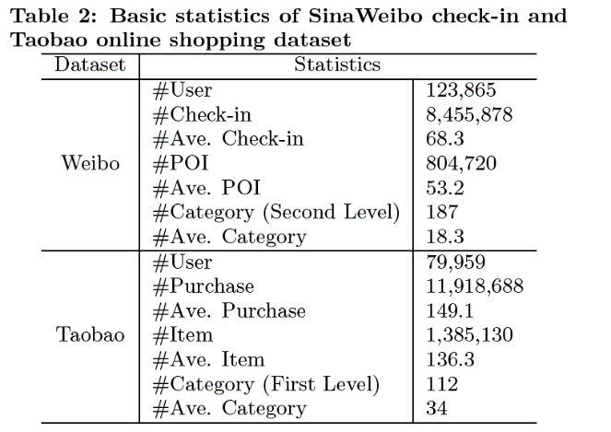
Data
Remove outliers and clean up the data
Filter noisy data, e.g., repeated check-ins at the same place in quite a short interval
Require that every user on SinaWeibo should have at least 30 check-ins and that every user on Taobao should have purchased at least 30 times

Slide 16
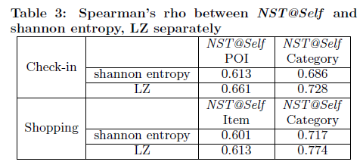
Experiments
Two model-free methods in information theory: Shannon entropy and Lempel-Ziv estimator (conditional entropy)
Weakness of model-free methods
Can not be applied for prediction directly
Measure user status in a whole, can not reflect the novelty-seeking status at each moment

Slide 17
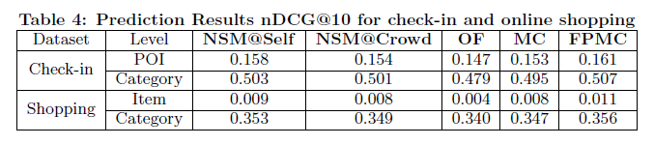
Experiments
Prediction
OF (Order by Frequency): individual's visit frequency in the past
MC (Markov Chain): learning a transition graph over POIs
FPMC (Factorized personalized Markov Chain): embedding users' preferences and their personalized Markov Chains

Slide 18
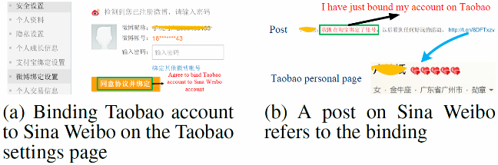
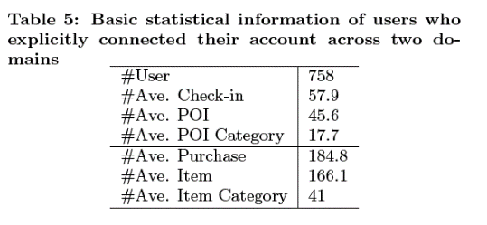
Experiments
NST Across Heterogeneous Domains
Identify users both share check-in and online shopping behavior

Slide 19
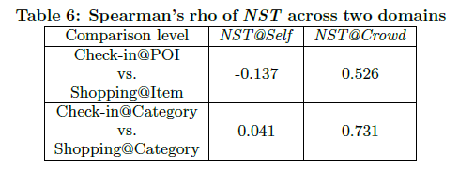
Experiments
NST Across Heterogeneous Domains
NST@Self inconsistent while NST@Crowd consistent
Historical movement can imply whether to recommend the most popular products in an e-business website

Slide 20

Consumer Impulsivity
For each Individual, given the stimuli perceived from social network and consumption activities, infer his consumer impulsivity.
Would a consumer purchase products on Amazon triggered by promotion messages or friend suggestions on Twitter or Facebook
Notes:
So, what is our task in this work. For each individual, if given the stimuli perceived from social network and his consumption activities, we want to infer his consumer impulsivity in a data-driven way. Compared to traditional survey or interviewed method, our method can be applied on a large-scale population and can avoid some shortcoming of these methods, such as be
So our work would answer the following question, would a consumer
Fuzheng Zhang, Nicholas Yuan, Kai Zheng, Defu Lian, Xing Xie, Yong Rui, Mining Consumer Impulsivity Attribute from Offline and Online Behavior, 2015 ACM International Joint Conference on Pervasive and Ubiquitous Computing (UbiComp 2015), Osaka, Japan, Sep. 2015

Slide 21
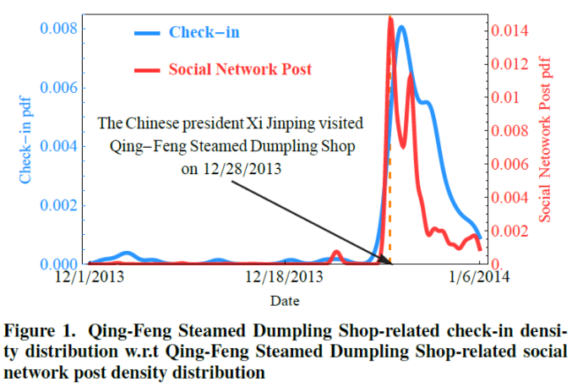
Social Network Stimuli
A typical example for offline consumption
Check-in data (consumption activity)
Social networks post (stimuli resource)
Notes:
In our dataset, we also find a typical example for offline consumption. Here, for consumption activity, we use check-in data. For stimuli on social network, we use the post data. This figure shows that Chinese president, Xi jinping will visited a restaurant called Qing-Feng Steamed Dumpling Shop on Dec 28, 2013, so there are a lot twetts on social network talking about this event. The interest thing is, in the following days, many users will also visit that shop, obviously, we can say that they are influenced by the information on social network, social network actually act as a stimuli for this offline consumption behavior.

Slide 22
Item Stimulus Matrix
Notes:
Now, before talking about our model, I will introduce some concept related to it. Consumer behavior is sequence, where each node means that he has a purchase behavior. The sequence is in a chronological order. For his each consumption behavior, we assume there are some candidates for him, what we mean option. For each consumption behavior, we also focus on the recent posts this user sees on social network, and we will compute that a candidate is talked frequently or not on the social network. So dynamic option matrix actually describe this. For all the candidate, we will order them by this frequency, where large value means frequency is large. So the column of the matrix is the candidates, the row describe for each consumer behavior, the order the candidate frequency on social network.

Slide 23
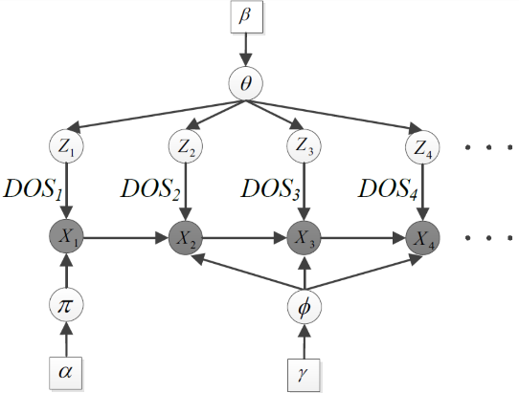
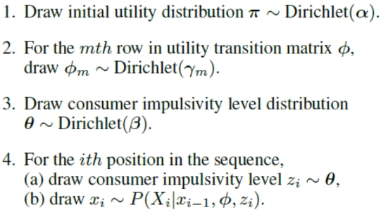
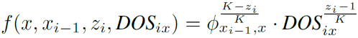
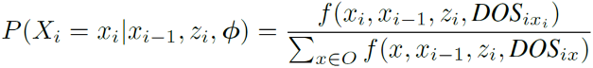
Consumer Impulsivity Model
Observation generation procedure:

Slide 24
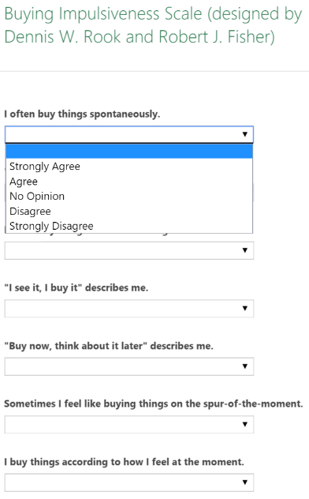
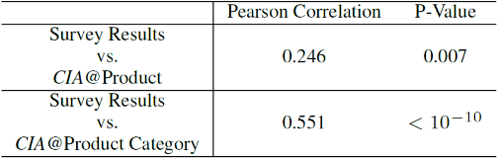
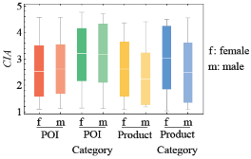
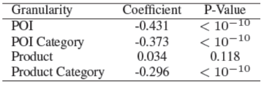
Effectiveness
CIA and Survey-based Result
Get survey results
Online shopping data, 976 users published email address. Then send invitations, 103 returned (56 males, 47 females)
Check-in data, only 21 users have email, ignored
CIA and demographics
Survey scale
Notes:
How evaluate the effectiveness of our inferred consumer impulsivity, we compare it with survey result. This validate that our mode is effective, and it is at some extent consistent to survey results.
For check-in, nearly no difference between male and female. The reason might be that most of consumption related check-in behavior are dining behavior, there is no explicit impulivie dining preference. For product and product category, we can see that female is acutally more impulsivie than male. Which is consistent that with our intuition, female is more emotional and is more easily to be persuade to buy something.

Slide 25
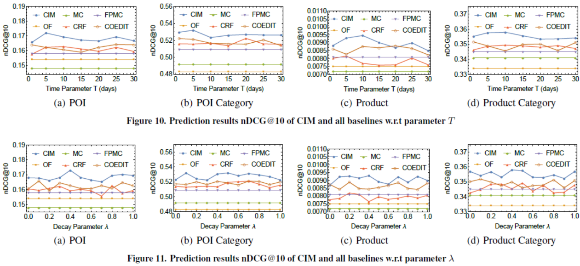
Performance with parameter $T$ and $λ$
Our model outperforms OF, MC and CRF, because frequency, transition frequency and stimuli intensity has been captured
Notes:
transfers the social network stimuli
knowledge as a whole while our method investigates into
the connection of behavior and social network stimuli at each
time point

